Slide 1
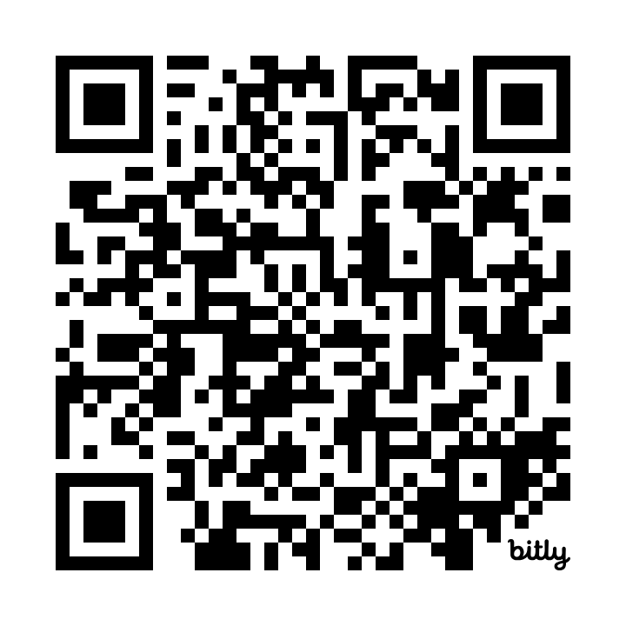
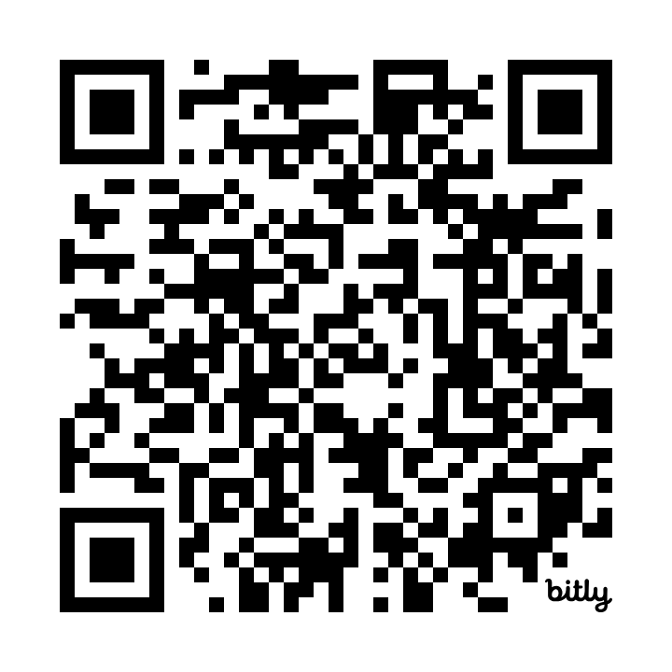
Anonymous Self-ID Survey
While you wait, we invite you to complete a voluntary survey to help ADOT understand who attends its public meetings and how the department can improve participation. English: https://bit.ly/ns-segment1-selfid-en
Mientras espera, lo invitamos a completar una encuesta voluntaria para ayudar a ADOT a comprender quiénes asisten a sus reuniones públicas y como podrá mejorar la participación. Español: https://bit.ly/ns-segment1-selfid-sp

Slide 2

North-South Segment 1 Tier 2 Environmental Impact Statement (EIS) and Design Concept Report (DCR) US 60 to Arizona Farms Road (State Route 505)
Public Information Meetings | May 15, 20 & 22, 2025

Slide 3


Meeting Purpose
Provide information and updates on the current status of the North-South Segment 1, Tier 2 Environmental Impact Statement (EIS) and Design Concept Report (DCR), US 60 to Arizona Farms Road (SR 505)
Seek public input to be considered by the study team on the project purpose and need and preliminary range of alternatives

Slide 4
Tier 2 Environmental Review Process
The National Environmental Policy Act (NEPA) requires:
Agencies to analyze, disclose, avoid, minimize, or mitigate adverse environmental impacts for studies with federal involvement
Applicable federal agencies to review the proposed project's impacts and mitigation documented during the NEPA process
Public involvement activities to identify public concerns/controversy, and to solicit public feedback on environmental impacts of the proposed project
A Tier 2 Environmental Impact Statement, under NEPA, will be prepared to evaluate potential impacts of the proposed project.

Slide 5
NEPA Disclosure
The environmental review, consultation and other actions required by applicable Federal environmental laws for this project are being or have been carried out by ADOT pursuant to 23 USC 327 and a Memorandum of Understanding dated 06/25/2024 and executed by FHWA and ADOT.

Slide 6
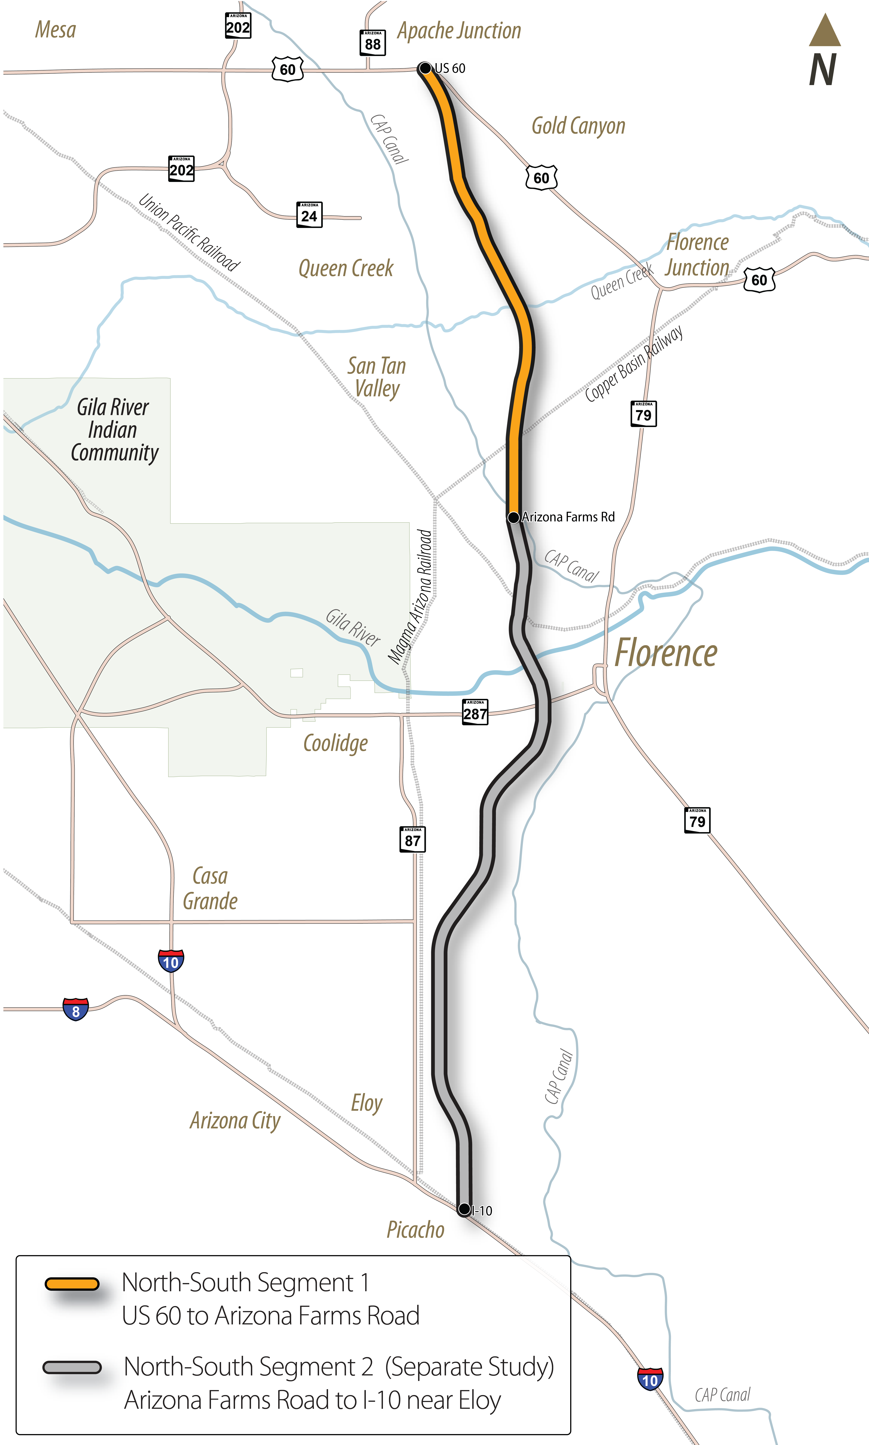
North-South Corridor Background
In Aug. 2021 ADOT selected a 1,500-foot wide North-South corridor through a Tier 1 Environmental Impact Statement (EIS)/DCR process
Corridor spans over 50 miles between US 60 and Interstate 10 (I-10)
The Tier 1 North-South Corridor was split into two segments for Tier 2 analyses, the Segment 1 Study and Segment 2 Study

Slide 7
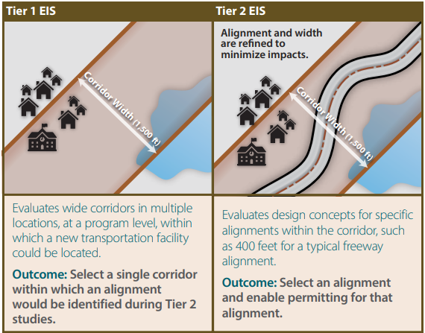
Tier 1 Studies vs Tier 2 Studies

Slide 8
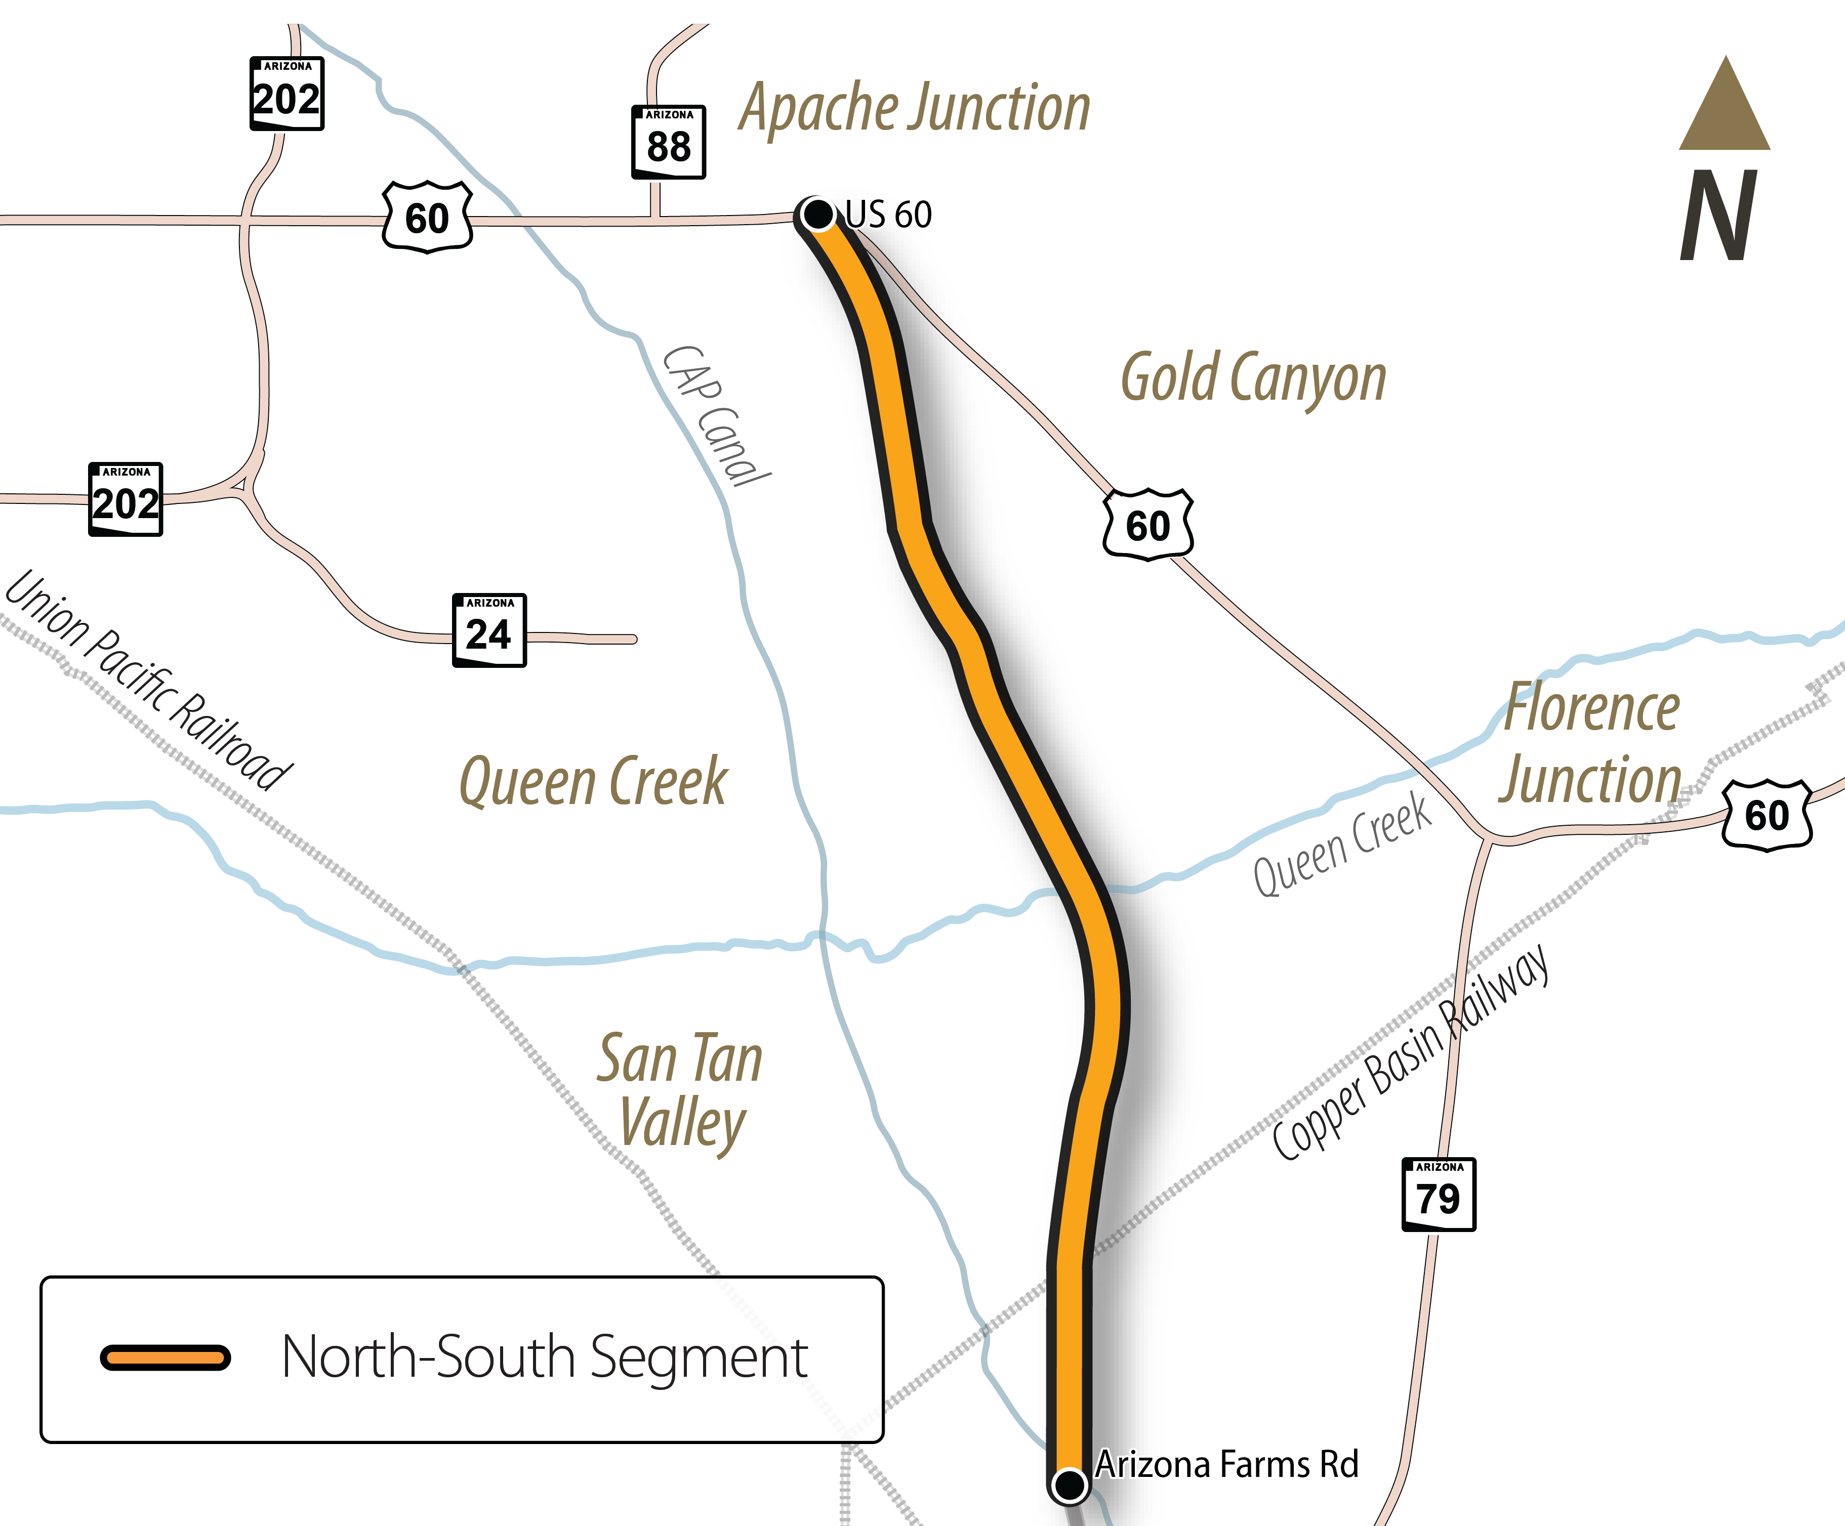
Study Area
Segment 1 Study extends from US 60 to Arizona Farms Road
Approximately 20 miles long

Slide 9
Study Goals
The current phase of the study will:
Refine the purpose and need for the proposed project
Develop a preliminary range of alternatives for potential 400-foot-wide freeway alignments within the 1,500-foot corridor established in the Tier 1 EIS
Review the potential interchanges found in the Tier 1 to inform initial interchange design concepts
Ultimately the study will:
Recommend a preferred alternative for the project alignment
Develop and circulate for public review and comment a Draft Tier 2 EIS and DCR that identifies the Preferred Build Alternative, which will be compared against the No Build, or do nothing alternative
Prepare a Final EIS and DCR document and Record of Decision identifying the Selected Alternative

Slide 10
What We Heard
Comment themes from the North-South 2023 public meetings include:
Various levels of support related to the need for the corridor
Ensuring coordination with recent and ongoing studies in the area
Utility and railroad impacts
Current and future traffic congestion
Environmental impacts of a new highway
Impacts to existing and planned surrounding communities and individual property owners

Slide 11
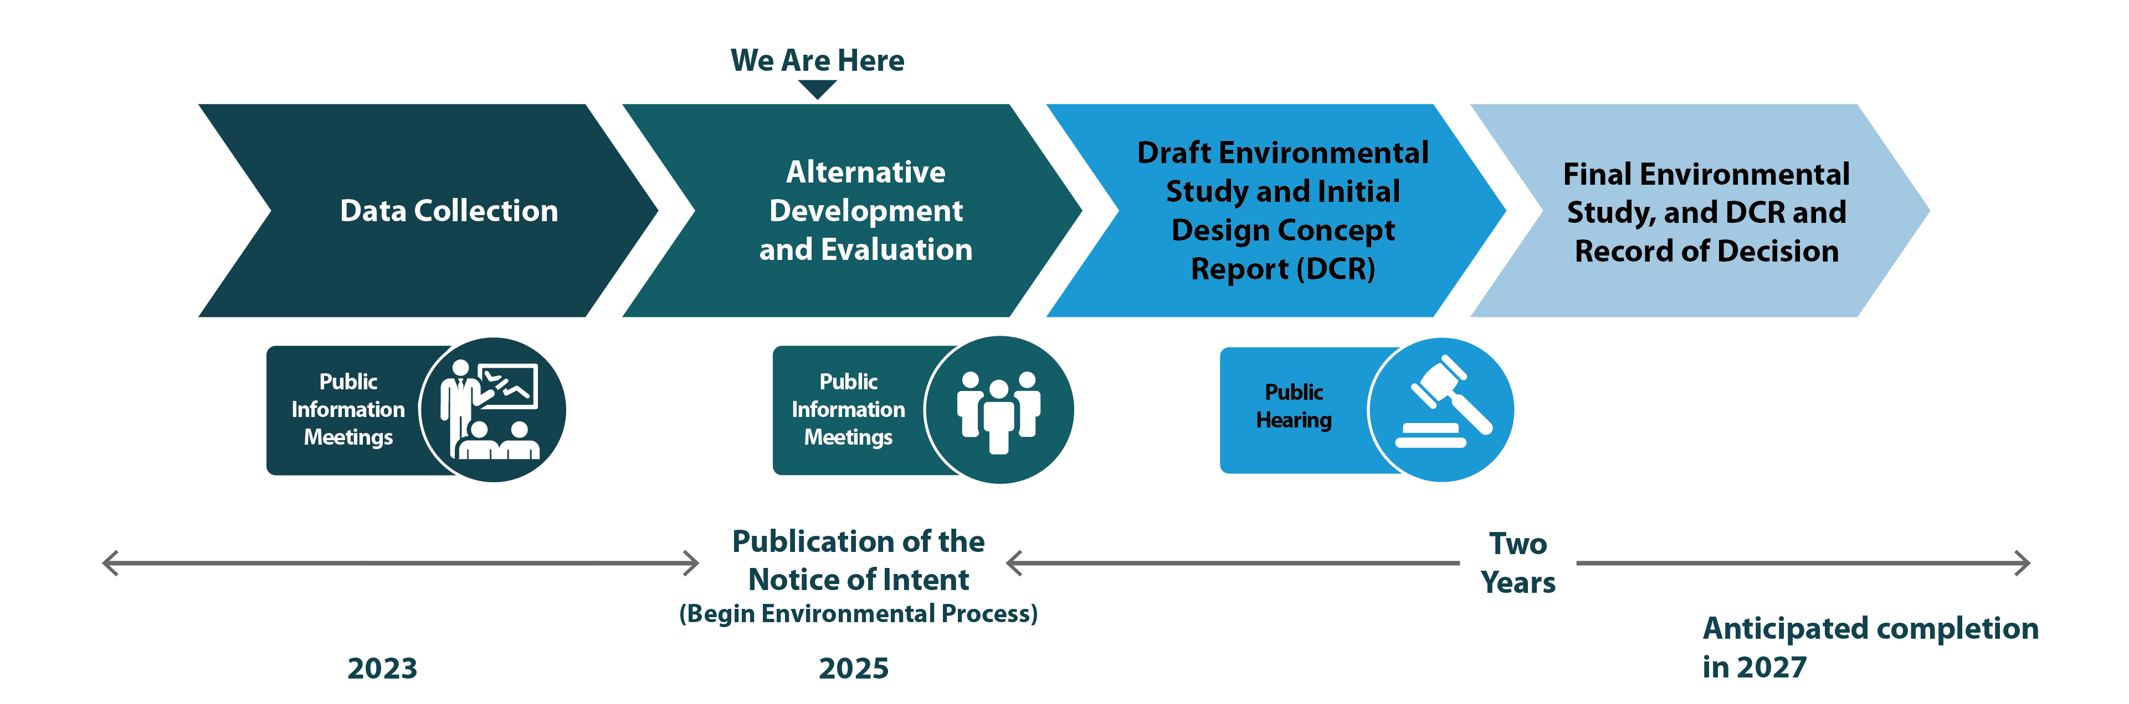
Study Schedule
*Schedule subject to change

Slide 12
Preliminary Purpose and Need
The purpose and need of the North-South Corridor between US 60 and I-10 was established during the Tier 1 EIS study process.
A refined needs assessment specific to Segment 1 is available for review with the Notice of Intent (NOI) on the study website.
Comments on the preliminary Purpose and Need are welcomed during the current comment period.
The Preliminary Purpose and Need may be revised based on comments received.

Slide 13
Preliminary Purpose and Need
The purpose and need for the proposed project is to establish a new, continuous, controlled-access north-to-south transportation corridor to:
Improve access to future activity centers
Improve regional mobility
Improve north-to-south connectivity
Integrate the region’s transportation network
Address existing and future population and employment growth

Slide 14
Preliminary Alternatives Development Process

Slide 15
Constraint Evaluation Process
We Are Here
Evaluate Comments to Refine Build Alternatives for EIS
Environmental Technical Studies and EIS Impact Analysis
Develop Preliminary Range of Build Alternatives for NOI
Publish NOI
Map Constraints within 1,500’ corridor
Identify Constraint Opportunity Areas
Agency/Stakeholder/Tribal Involvement

Slide 16
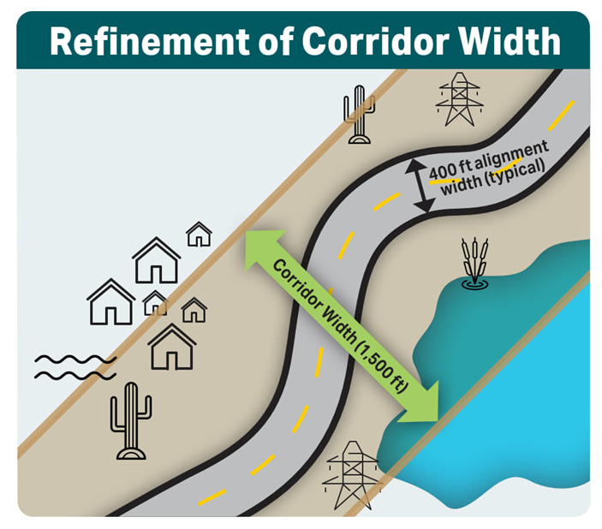
Map Constraints within Study Corridor
Cultural Resources
Section (4f)
Clean Water Act/Section 404
Hazardous Materials
Biological Resources
Wildlife Habitat and Connectivity
Prime and Unique Farmland
Social and Economic Considerations
Noise
Drainage and Floodplains
Major Utilities
Terrain
Existing Infrastructure and Feature Crossings (CAP Canal, Magma Arizona Railroad)
Agency, Tribal, Stakeholder, and Public Input

Slide 17
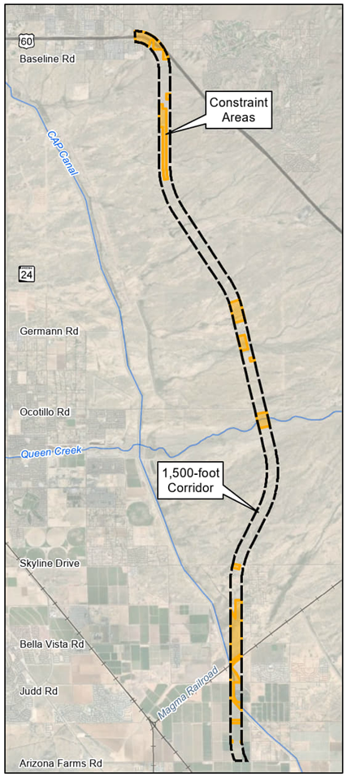
Constraint Mapping Results
Legend
Constraint present based on preliminary data and information.
Identified constraint and opportunity areas based on preliminary and technical considerations
Constraint areas represent various environmental resources and technical/engineering considerations
Used to develop preliminary alignment alternatives to avoid or minimize potential impacts

Slide 18
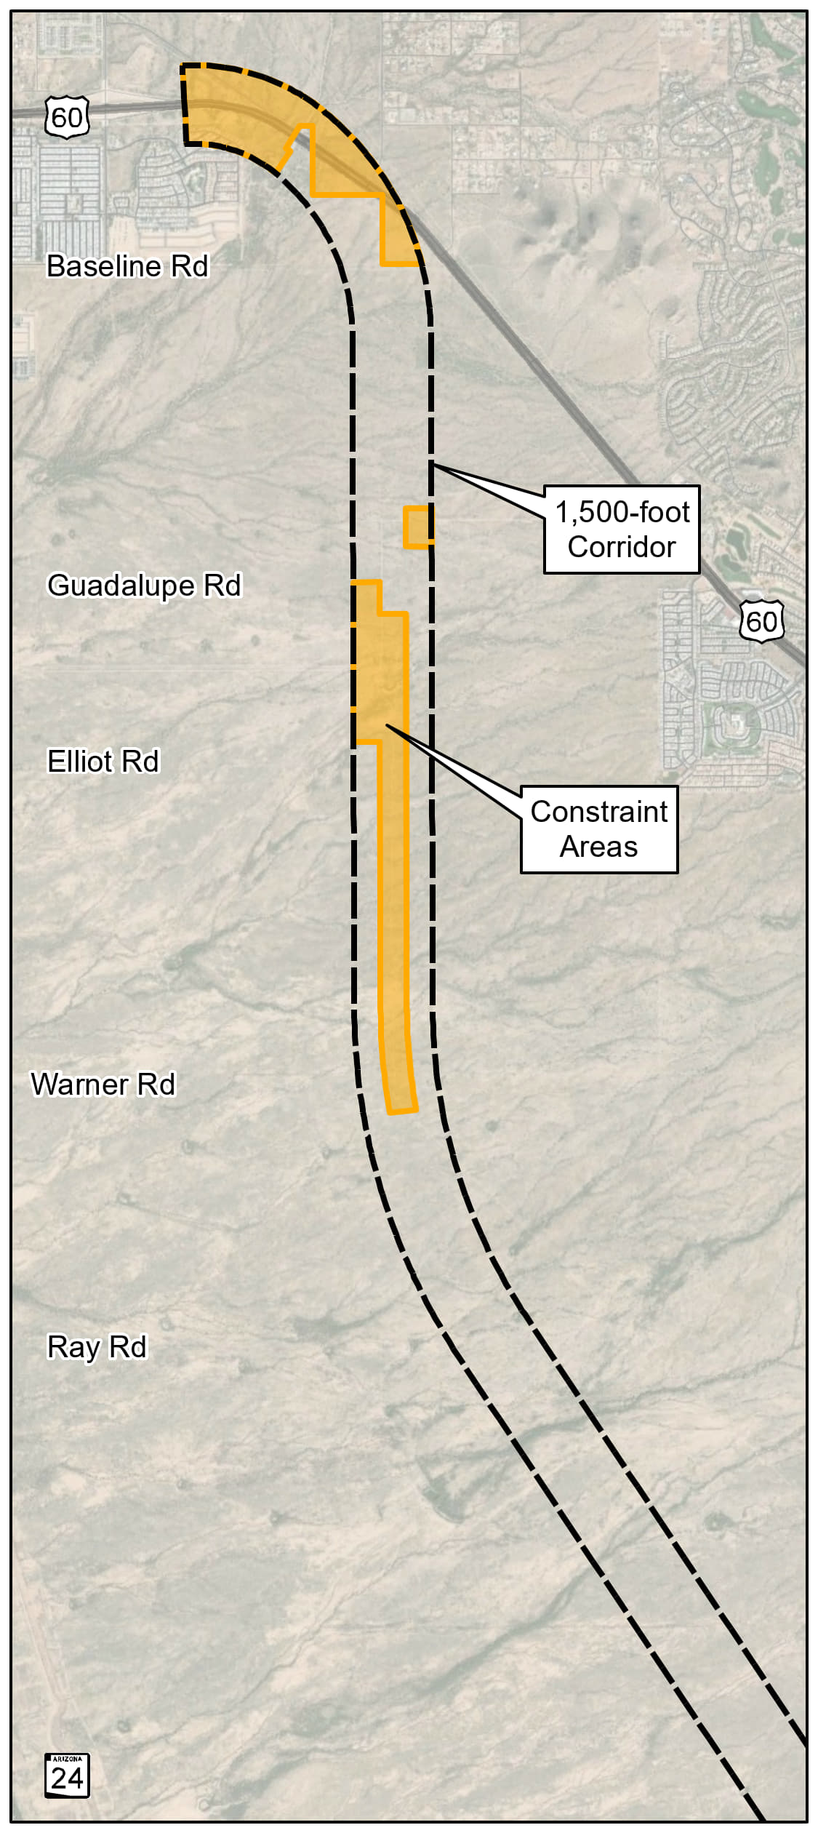
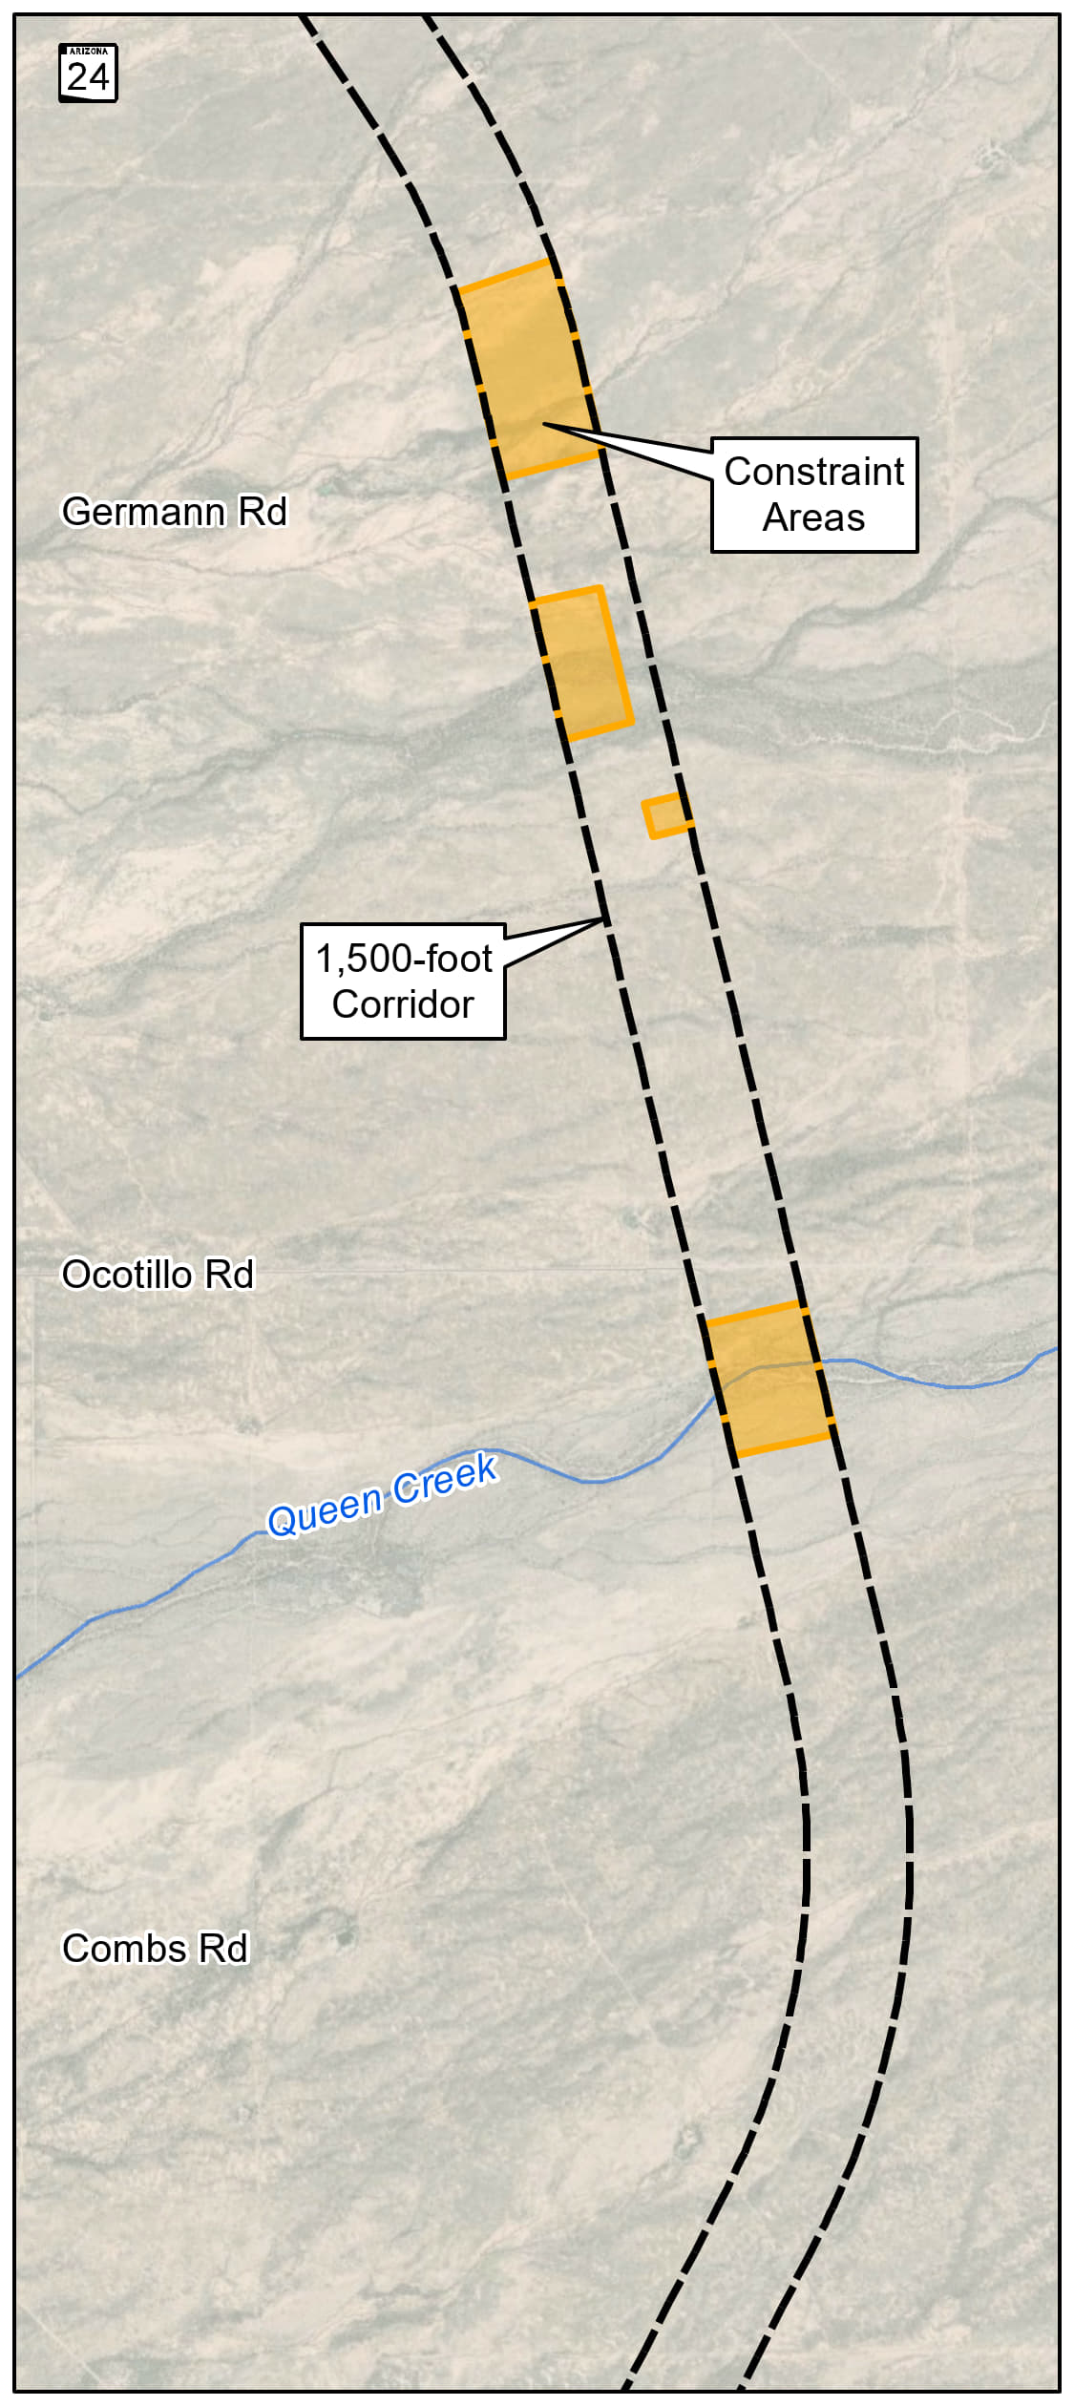
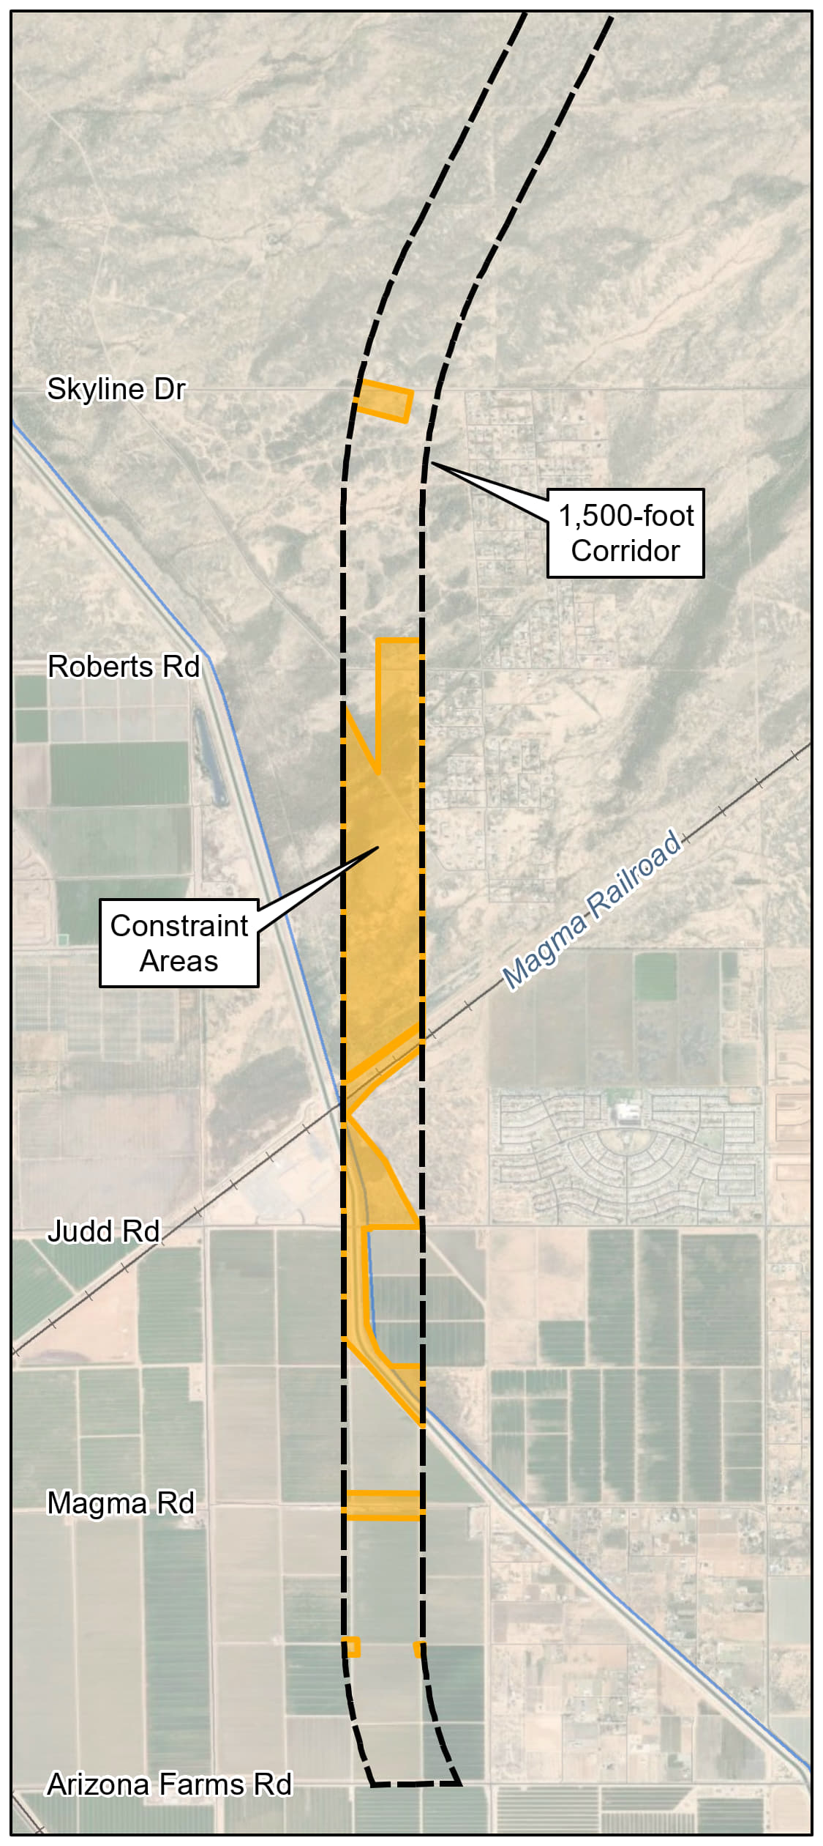
Constraint Mapping Results

Slide 19
Preliminary Range of Alternatives

Slide 20
Preliminary Range of Alternatives
Preliminary build alternatives identified by a line in the center of the 400-foot highway alignment
Preliminary alignments were developed to provide a range of alignment alternatives through constrained areas
Includes the Preliminary No Build Alternative, which consists of future conditions in 2050 without implementation of a new north-south freeway corridor

Slide 21
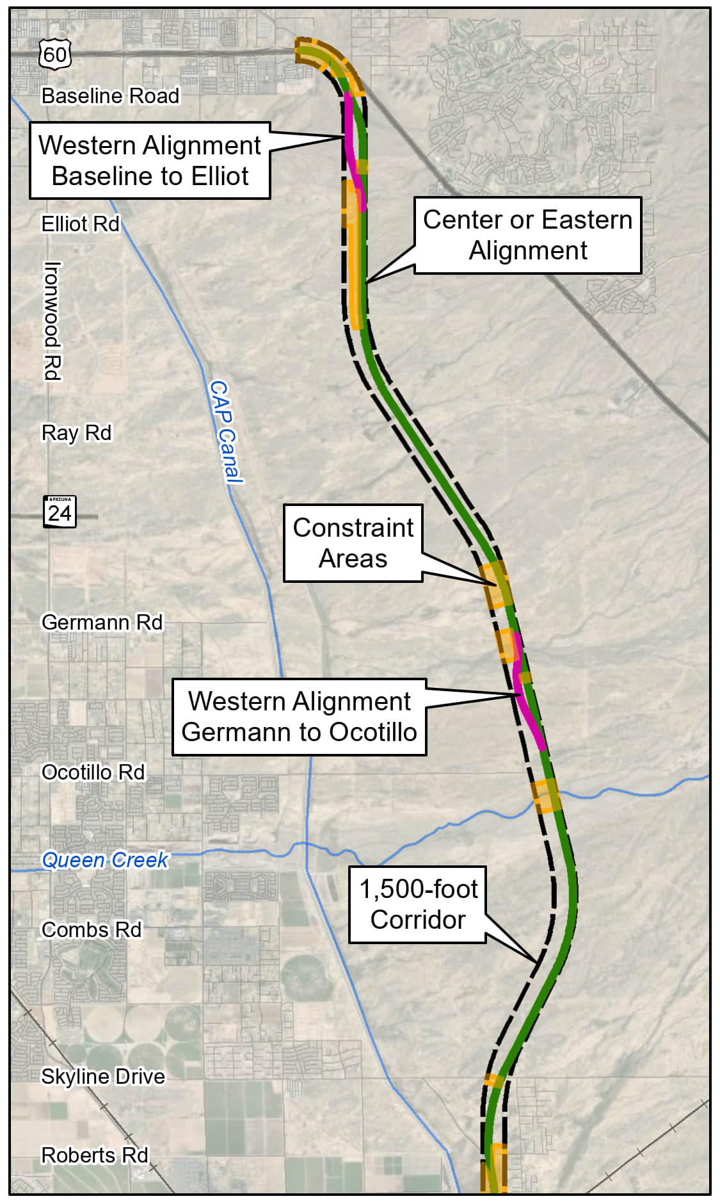
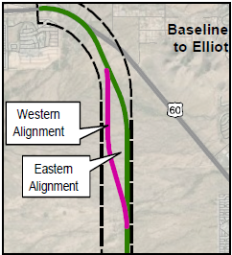
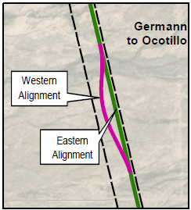
Preliminary Alignments: US 60 to Roberts Road
Preliminary alignment generally within center/eastern zones of the corridor (green)
Two alignment alternatives in two areas:
Baseline to Elliot Rd: western (pink) or eastern alignment (green)
Germann to Ocotillo Rd: western (pink) or eastern alignment (green)

Slide 22
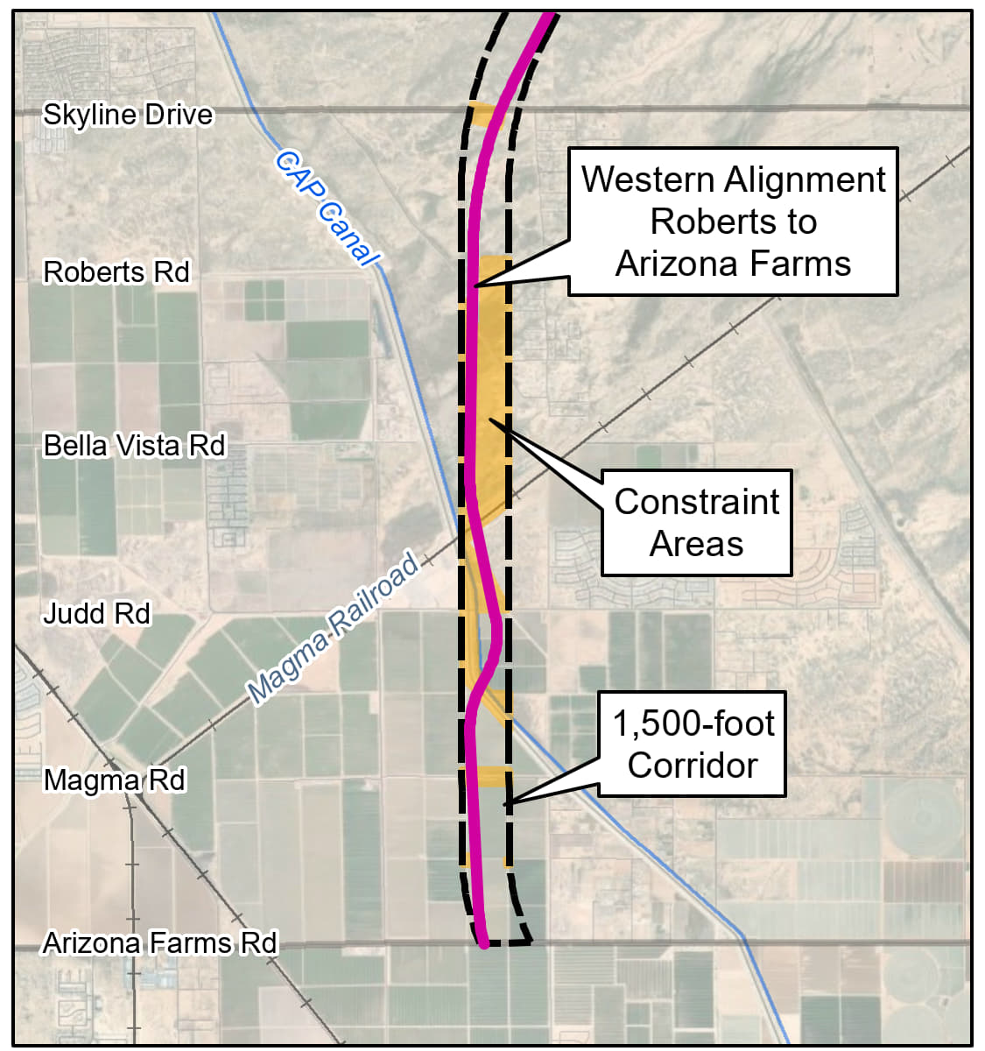
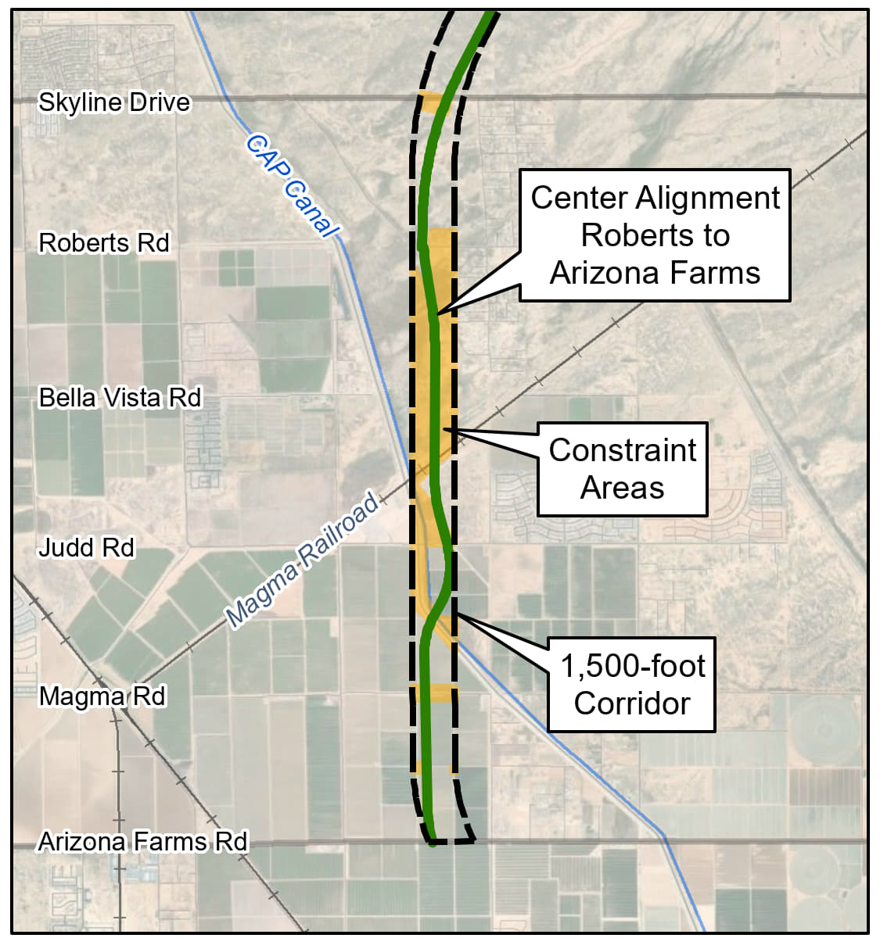
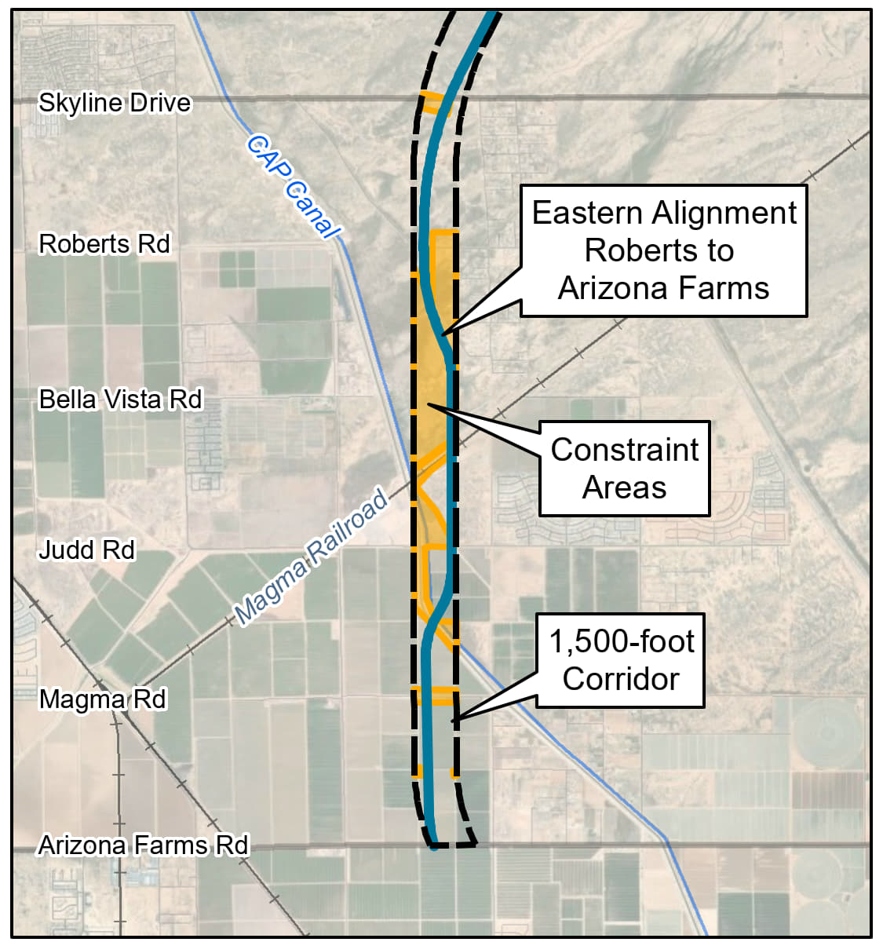
Preliminary Alignments: Roberts Road to Arizona Farms Road
Three preliminary alignment alternatives within the corridor:
Western (pink), center (green) and eastern (blue).

Slide 23
Preliminary End-to-End Build Alternatives
Three preliminary end-to-end alternatives were developed
May be refined through further evaluation and public, agency and tribal government input through the EIS process
As the study progresses, ADOT may recommend a hybrid of these alignment alternatives

Slide 24
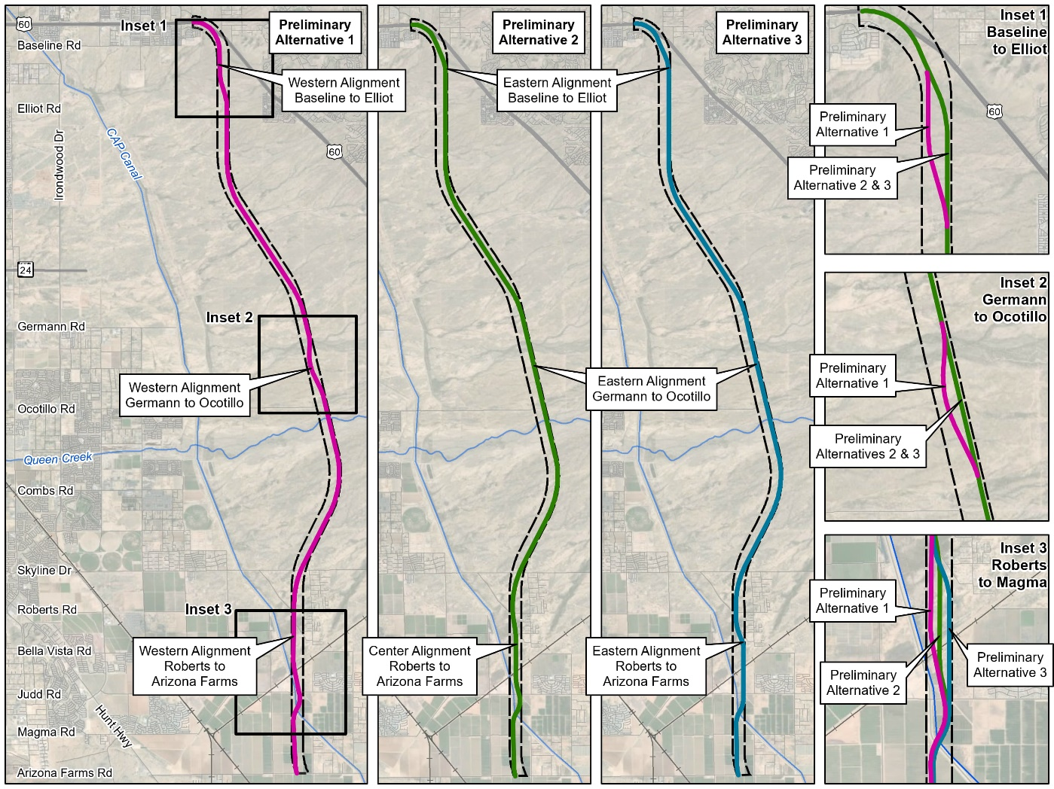
Preliminary End-to-End Build Alternatives

Slide 25
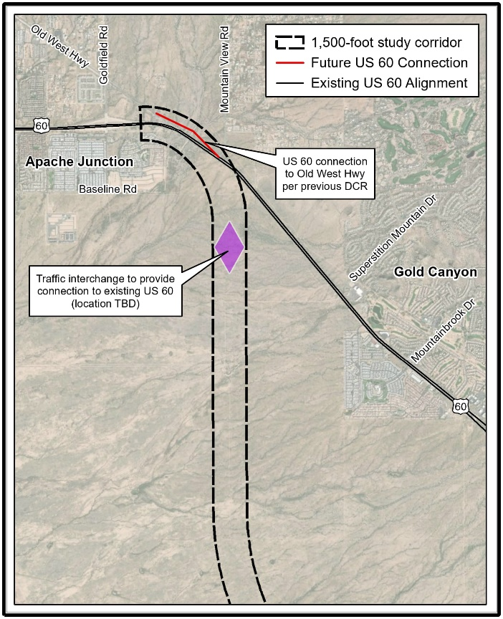
Preliminary Alternative Connection to US 60
Direct connection between US 60 to SR 505
Existing US 60 east of Mountain View Rd to remain (with access points and traffic signals)
New traffic interchange and roadway connection at Houston Ave to connect to US 60 in Gold Canyon
Connect Old West Highway to the existing US 60 at Goldfield Road
US 60/Goldfield Road interchange to remain

Slide 26
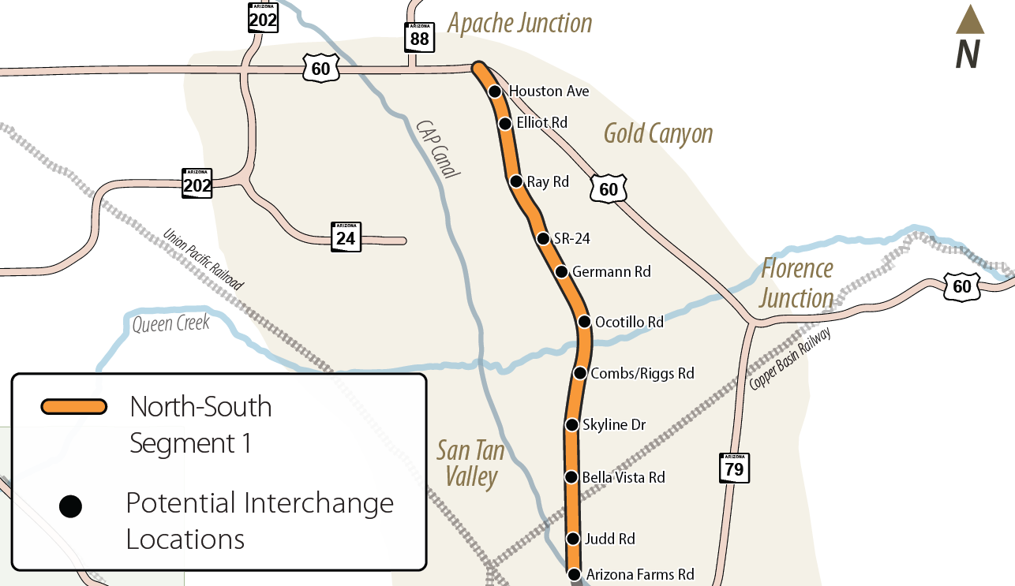
Preliminary Traffic Interchanges
Previous Tier 1 EIS identified potential interchange locations
List refined for further study in Tier 2 EIS:
Houston Ave
Elliott Rd
Ray Rd
SR 24
Germann Rd
Ocotillo Rd
Combs Rd/Riggs Rd
Skyline Dr
Bella Vista Rd
Judd Rd
AZ Farms Rd

Slide 27
Other Studies
Maricopa Association of Governments
Superstition Vistas Multimodal Transportation Planning Study
ADOT
US 60 Gold Canyon Bypass Study and DCR (2012)
AZ Passenger Rail Corridor Study Tier 1 EIS (2016)
Pinal County
Central Arizona Parkway
State Route 24 Extension, Ironwood Dr to US 60

Slide 28
Project Status
No timeline to construct the North-South corridor, since it is not currently funded for design or construction.
Funding must be identified to issue a Record of Decision for a North-South Build Alternative in order to advance the project design and/or right-of-way acquisition.

Slide 29
Next Steps

Slide 30
What We Need From You
ADOT is currently seeking input on:
Comments or concerns on the preliminary purpose and need for the study
Comments or concerns on the preliminary range of alternatives for the study
Comments or concerns on the preliminary interchanges for the study
Comments or concerns on the environmental considerations for the study
Location specific comments for the study

Slide 31





How to Comment
Provide comments through
June 10, 2025.
Attend one of our public meetings (in-person or virtual) Online comments: www.northsouth-segment1.com
Email: info@northsouth-segment1.com Call: 602-474-3990
Mail: ADOT NSCS Segment 1 c/o HDR, Inc.
20 E. Thomas Rd., Suite 2500
Phoenix, AZ 85012

Slide 32
Questions?

Slide 33
Thank you!

